Slide 1
Introduction to Embedded System
Presented By
Dhan Pd. Poudel
Email: dhan.prasad@gmail.com

Slide 2
Agenda
Introduction to Embedded System
General Characteristics of Embedded System
Classification of Embedded System
Essential Components of Embedded System
Overview of Processors and Hardware Units in an Embedded system
Application of Embedded System

Slide 3
What is a system?
A system is a way of working, organizing or doing one or many tasks according to a fixed plan, program or set of rules.
For example: Watch is a time display system with parts: Hardware, Needles, Battery, Dial, Chassis and Strap.
Rules:
All needles move clockwise direction.
A thin needle rotates every second.
A long needle rotates every minute.
A short needle rotates every hour.
All needles return to the original position after 12 hours.

Slide 4
Introduction to Embedded System
David E. Simon “People use the term embedded system to mean any computer system hidden in any of these products.”
Todd D. Morton “Embedded Systems are electronic systems that contain a microprocessor or microcontroller, but we do not think of them as computers – the computer is hidden or embedded in the system.”
Tim Wilmshurst
“An embedded system is a system whose principal function is not computational, but which is controlled by a computer embedded within it. The computer is likely to be a microprocessor or microcontroller. The word embedded implies that it lies inside the overall system, hidden from view, forming an integral part of greater whole. ”
“An embedded system is a microcontroller-based, software-driven, reliable, real time control system, autonomous, or human- or network-interactive, operating on diverse physical variables and in diverse environments, and sold into a competitive and cost-conscious market”.

Slide 5
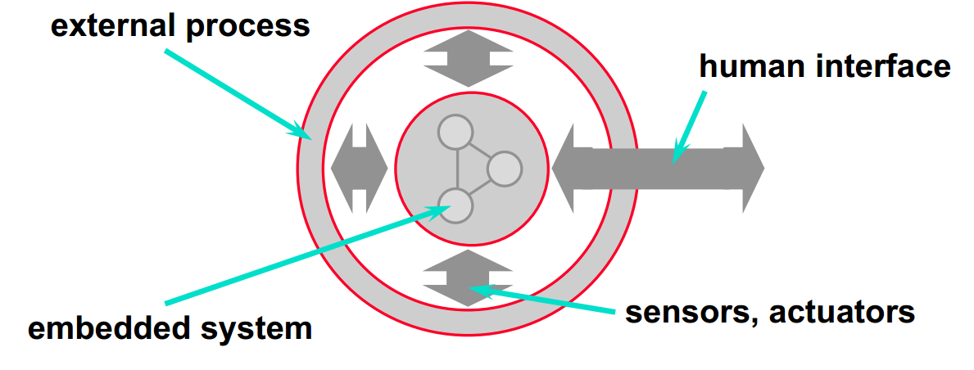
Introduction to Embedded System
Any device that includes a computer but is not itself a general-purpose computer(Mainframe or Desktop).
Respond to the external events.(e.g. someone pushes an elevator button.)

Slide 6
Introduction to Embedded System
Part of the large system.
Expected to function without human intervention.
Their work is subject to deadlines.
Combination of software and hardware.
Current ES are Multi-core, Multi-Platform mostly in real time and at Low Power Consumption.

Slide 7
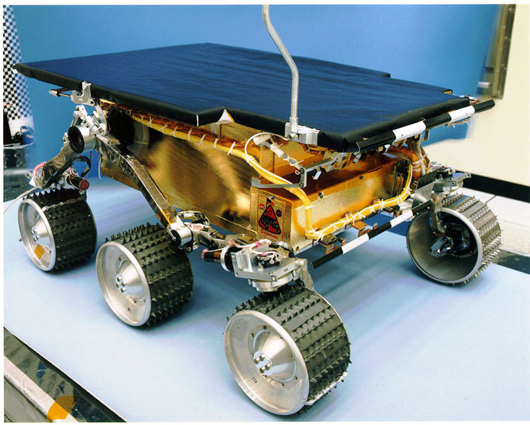
Introduction to Embedded System
Examples:
Product: NASA’s Mars Sojourner Rover. Microprocessor: Intel 8-bit 80C85, 512 kB of RAM, 176 kb of flash memory, Vxworks operating system, 3- Navigation Cameras.
Notes:
landed on July 4, 1997
Sent 550 photos to earth

Slide 8

Introduction to Embedded System
Examples:
Product: Sony Aibo ERS-110 Robotic Dog. Microprocessor: 64-bit MIPS RISC.
Notes:
Artificial Intelligence Robot(Aibo) was marketed to use as “Entertainment Robot”. Widely adopted by universities for educational purposes.
What they have in common is that they sense the environment i.e, decide on(compute) their actions(responses) in real time.

Slide 9
General Characteristics of ES
Single-functioned
Executes a single program, repeatedly
Tightly-constrained
Low cost, low power, small, fast, etc.
Real-time
Must compute certain results in real-time without delay.
In Hard Real time any delay in deadline could result in a catastrophe.

Slide 10
General Characteristics of ES Contd.
Must be Dependable
Reliability, Maintainability, Availability, Safety, Security.
Reactive
Continually reacts to changes in the system’s environment.
Sophisticated Functionality
Often have to run sophisticated or multiple algorithms for
example cellphones, laser printer.

Slide 11
Classification of ES
Small Scale ES:
Single 8-bit or 16-bit Microcontroller.
Little Hardware and Software complexity.
They may be battery operated.
Usually C may be used to develop such system.
Programming Tools:
Editor, Assembler and Cross Assembler.
Example: Stepper motor controller for a robotics system, Washing system, Computer Mouse, Printer, Scanner, Remote controller etc…

Slide 12
Classification of ES Contd.
Medium Scale ES:
Single or few 16 or 32-bit microcontrollers or Digital Signal Processors(DSP) or Reduced Instruction Set Computers(RISC).
Both Hardware and Software Complexity.
Programming tools
RTOS, Source Code Engineering tool, Simulator, Debugger and Integrated Development Environment(IDE).
Example: Banking systems like ATM and Credit card transactions, Entertainment systems like Video and Music system etc…

Slide 13
Classification of ES Contd..
Sophisticated ES:
Enormous Hardware and Software complexity.
May need scalable processor or configurable processor and programming logic arrays.
Constrained by the processing speed available in their hardware units.
Example: Real time video processing system, Speech or Multimedia processing system.
Programming Tools
For these systems may not be readily available at reasonable cost or may not be available at all. A compiler or retargetable compiler might have to be developed for this.

Slide 14
Essential Components of ES
Embeds hardware.
Processors, Timers, Interrupt Controller, I/O devices, Memories, Ports etc.
Embeds main application software generally into flash or ROM and the application software performs concurrently the number of tasks.
Embeds a real time operating system, which supervises the application software tasks running on the hardware and organizes the accesses to the system resources according to priorities and timing constraints of tasks in the system.

Slide 15
Overview of Processors in ES
General Purpose Processor
Microprocessor
Intel : 8085, 8086, 80186, 80188, 80286,80386
Motorola: 6800, 6809, G3, G4,G5
Microcontroller
Intel: 8032, 8051, 8052
PIC: 8-bit PIC 16, PIC18, 16-bit DSPIC33/PIC24
Motorola: 6811
Embedded Processor
AndeScore N9/10/12, ARM 7/9/11, Intel i960, AMD 29050.
Digital Signal Processor
PAC, TMS32oCXX, SHARC, Motorola 5600XX.
Notes:
Embedded Processor: Special microprocessors & microcontrollers often called, Embedded processors. An embedded processor is used when fast processing fast context-switching & atomic ALU operations are needed
DSP:
It includes the computational capabilities of microprocessor and multiply & accumulate units (MAC).
DSP has large number of applications such as image processing, audio, video & telecommunication processing systems.
It is used when signal processing functions are to be processed fast.


Slide 16
Overview of Processors in ES Contd..
Application-Specific Processor:
Dedicated to specific tasks like image compression and provides faster solution.
Used as an additional processing unit for running the application in place of using embedded software.
Example: IIM7100, W3100A.
Single-Purpose Processor
Digital circuit designed to execute only a single program.
Contains only the components to execute a single program.
No program memory.
Example: coprocessor, accelerator or peripheral.
Notes:
Coprocessor used to supplement the work of primary cpu.

Slide 17
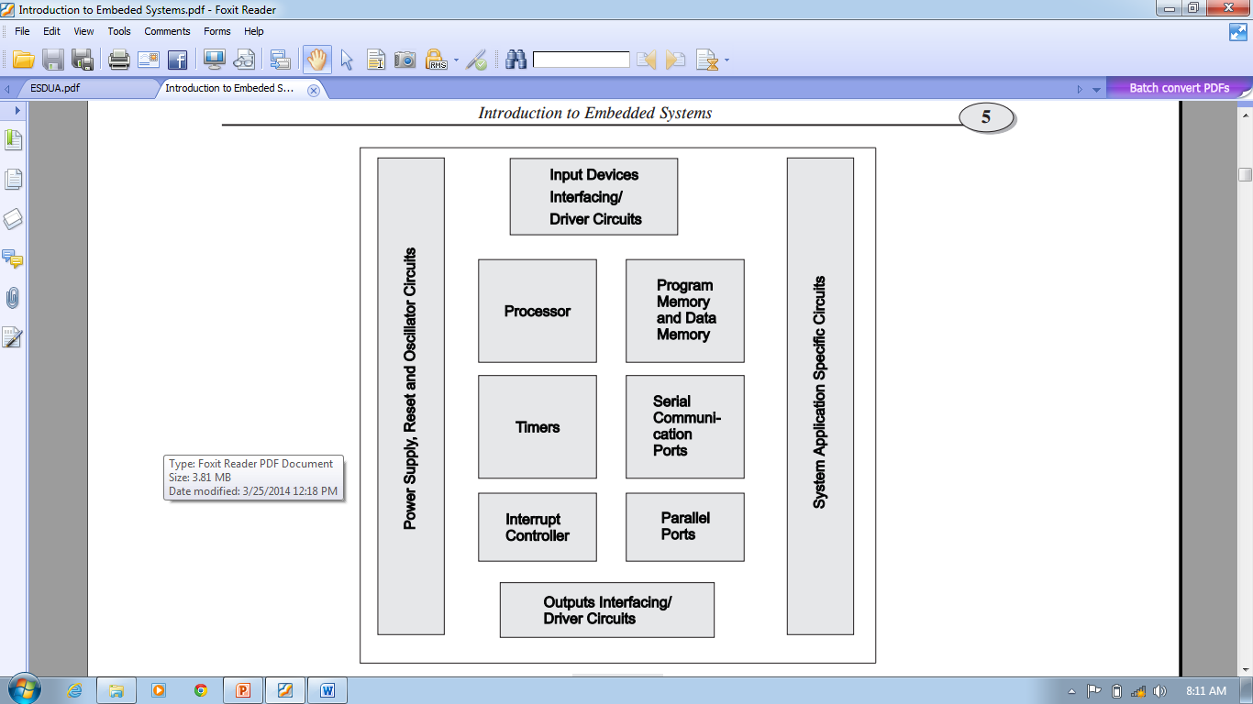
Hardware Units in Embedded System
Notes:
1. A microprocessor
2. A large memory comprising the following two kinds:
(a) Primary memory (semiconductormemories - RAM, ROM and fast accessible caches)
(b) Secondary memory (magnetic memory located in hard disks, diskettes and cartridge tapes
and optical memory in CD-ROM)
3. Input units like keyboard, mouse, digitizer, scanner, etc.
4. Output units like video monitor, printer, etc.
5. Networking units like Ethernet card, front-end processor-based drivers, etc.
6. I/O units like a modem, fax cum modem, etc

Slide 18
Application of ES
Automotive Electronics
Aircraft Electronics
Trains
Telecommunication
Medical Systems
Military Applications
Authentication Systems
Consumer Electronics e.g MP3 Audio, digital Camera, home electronics etc.
Robotics etc…

